Slide 1

SMART parking system
Presented By:
Dhruv Agarwal(23EEB0A12)
M. Gokul(23EEB0A23)
M. Hari(23EEB0A24)

Slide 2

Why Smart Parking is Important ?
Reduces traffic and road congestion Saves time in finding parking Minimizes fuel usage and cost Improves security with automated control
Enhances efficiency in parking management

Slide 3
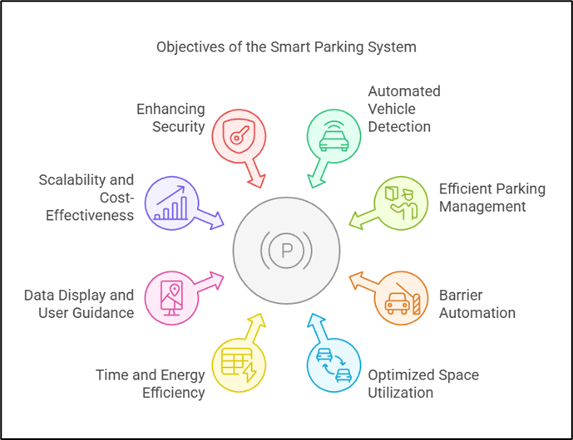
Objectives

Slide 4




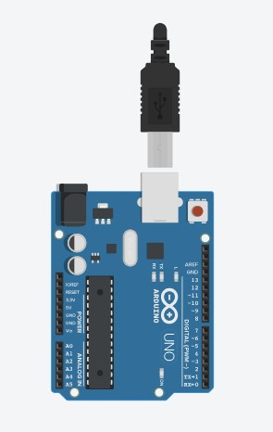
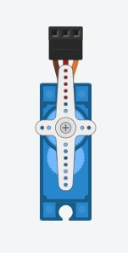
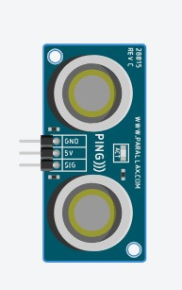
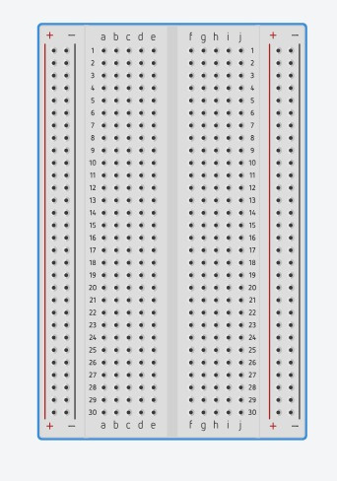
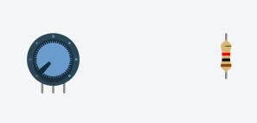


COMPONENTS
A
B
C
D
E

Slide 5
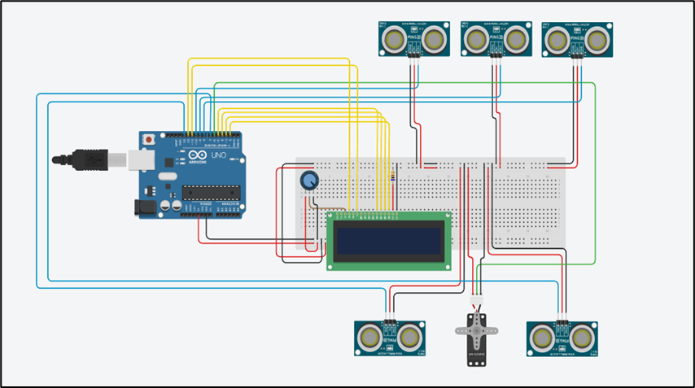
CIRCUIT DIAGRAM

Slide 6
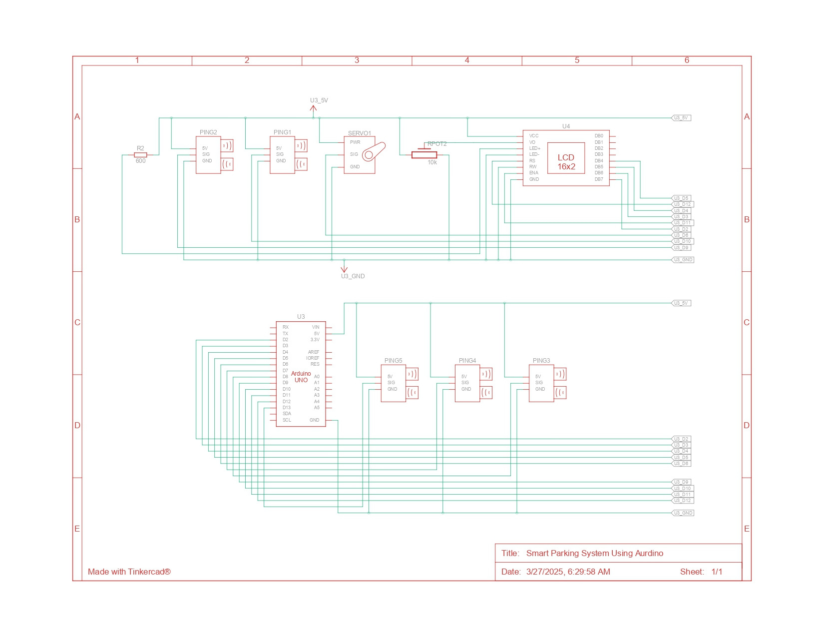
Schematic Diagram

Slide 7






WORKING
Car Detection Using Ultrasonic Sensor
The ultrasonic sensor continuously measures the distance in front of it. When a car is detected within a specific range, the system checks for available parking slots.
Barrier Control Using Servo Motor
If a parking slot is available, the Arduino sends a signal to the servo motor.
The servo motor then opens the barrier, allowing the vehicle to enter.
Displaying Parking Slot Information
The LCD screen updates in real time, showing the number of available slots. If no slots are available, it displays a "Parking Full" message

Slide 8
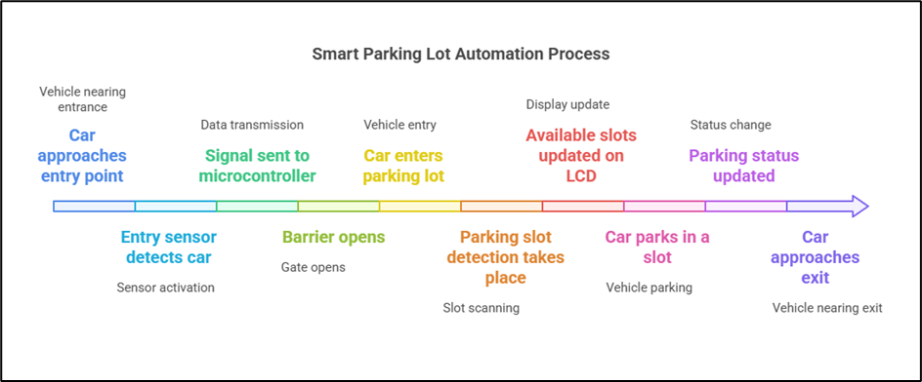
SEQUENCE OF EVENTS

Slide 9
Role of each component in automated parking system:
Arduino
Ultrasonic Sensors
LCD display
Servo motor
BreadBoard

Slide 10
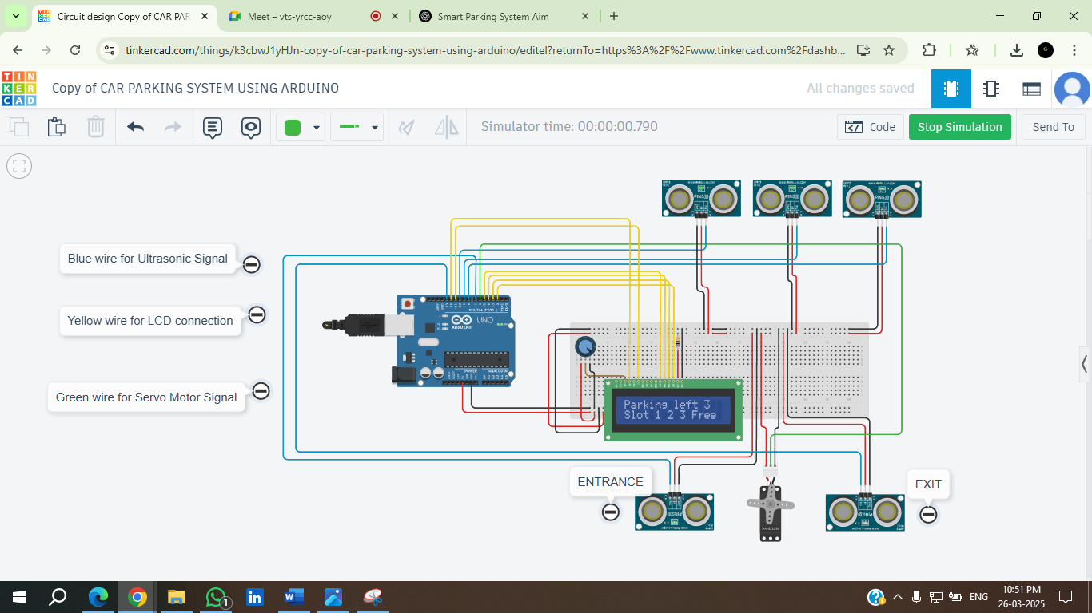
Simulation results
1) All Slots are free

Slide 11
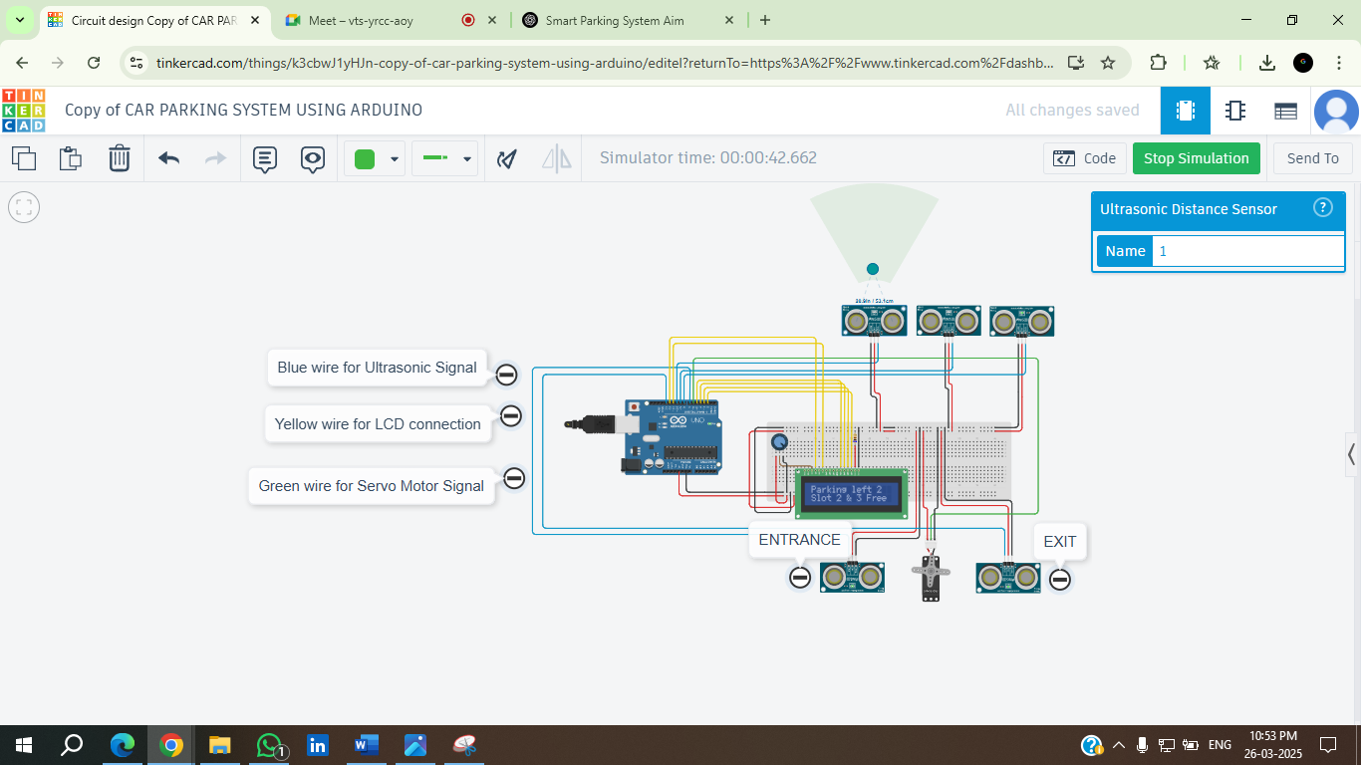
2)First slot is occupied

Slide 12
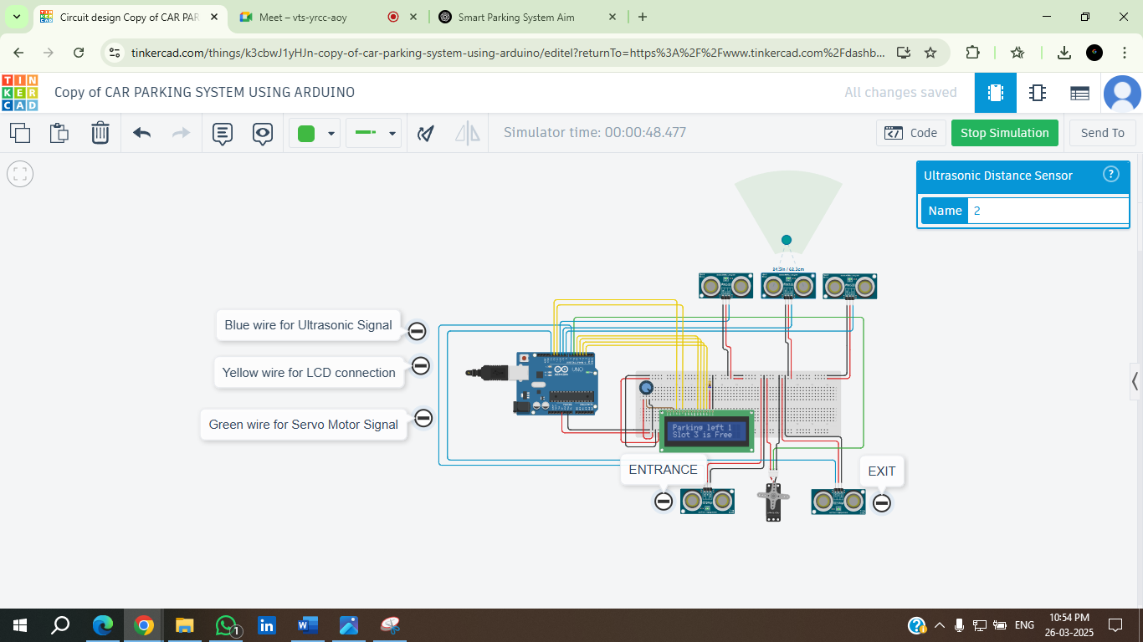
3) 2nd slot is also occupied

Slide 13
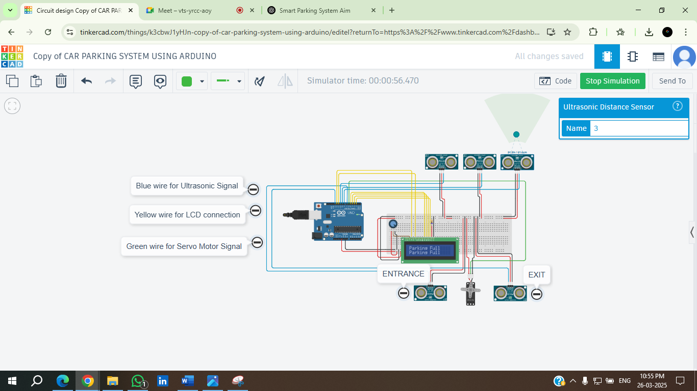
4) All slots are occupied

Slide 14
Future Scope
1.Mobile App Integration
2.IoT-Based Cloud Monitoring
3.Automated Payment System
4.AI-Powered Slot Allocation
5.Security Enhancements with CCTV & RFID

Slide 15
Applications
Shopping Malls and Commercial Complexes
Airports and Railway Stations
Corporate Offices and IT Parks
Smart Cities and Public Parking Areas.
Residential Apartments and Gated Communities

Slide 16
Summary
The system successfully detects vehicles using ultrasonic sensors.
The LCD display accurately shows the number of available parking slots.
The servo motor barrier operates automatically based on vehicle detection.
Entry and exit processes are automated, reducing manual effort.
The Smart Parking System using Arduino provides an efficient and automated solution for managing parking spaces.

Slide 17


thank you mam

